Slide 1

Python vs. C++
CS 201, Summer 2013

Slide 2
Undefined Behavior and Garbage
In Effective C++ by Scott Meyers, he talks about undefined behavior:
  Programmers coming to C++ from languages like Java or C# may be surprised at the notion of undefined behavior. For a variety of reasons, the behavior of some constructs in C++ is literally not defined: you can't reliably predict what will happen at runtime.
You can write code in C++ that is unpredictable! This isn't a feature; it's something you need to be aware of.

Slide 3
Undefined Behavior and Garbage
When you create a new variable in C++, it is not guaranteed to be initialized to a “safe” value.
For example, if you had a variable pointing to a memory address, it would be initialized as garbage.
If you try to access data outside of an array's predetermined size, you may get garbage.
Garbage is generally a place in memory that is not in use (ie, outside of an array) and therefore may contain data being used by another program. To the user, it will look like random garbage.

Slide 4
Garbage!
#include <iostream>
using namespace std;
int main()
{
int myArray[3] = { 2, 4, 6 };
for ( int i = 0; i < 5; i++ )
{
cout << i << ": " << myArray[i] << ", \t";
}
cout << endl;
return 0;
}
This program creates an array of size 3.
We iterate through the array, but we go from 0 to 5 (0, 1, 2, 3, 4).
myArray[3] and myArray[4] are indices outside of the array.

Slide 5
Garbage!
Remember our array's values:
int myArray[3] = { 2, 4, 6 };
The program is run multiple times. 3 and 4 are garbage, even though 3's value is prettier. Notice that 4's value changes each time.

Slide 6
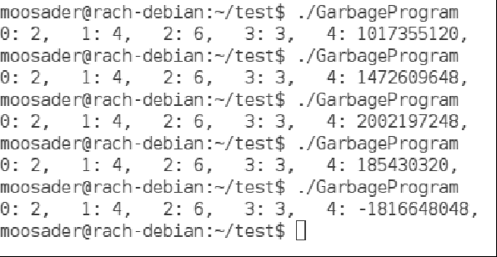

Slide 7
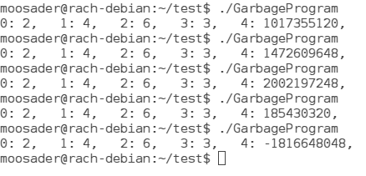

Garbage!

Slide 8
Avoid Garbage & Undefined Behavior
Check whether an index is OK before accessing that index of an array.
Initialize variables on declaration.
Responsible memory management

